Slide 1
Organization Visit
at
IFIC Bank
Team Members:
Farhan Islam Shuvro Faria Akter Busrat Jahan Sabiha
Roll : 1303 Roll : 1305 Roll : 1311
Mahir Faisal Ibne Bin Rafid
Roll : 1316 Roll : 1330
Course Coordinator:
Iftekharul Amin
Professor, IBA
University of Dhaka

Slide 2
We had the privilege of visiting the Paltan Branch of IFIC Bank in Bangladesh to gain valuable insights and firsthand experience with the assistance of Md. Enzamam Ibne Basar. This visit provided us with a unique opportunity to explore the operations and functions of IFIC Bank, one of the leading financial institutions in the Bangladesh.
During the visit, we had the chance to interact with professionals and experts within the bank, allowing us to learn about their day-to-day activities, the financial services they offer, and their commitment to customer satisfaction.
We engaged in discussions with both their Cyber Security Team and Network Team, and were granted the opportunity to conduct a visit to their data center, which we greatly appreciated.
We inquired about various aspects of their organization, such as the organizational structure, organizational culture, and the organization's perspective on a global scale.

Slide 3
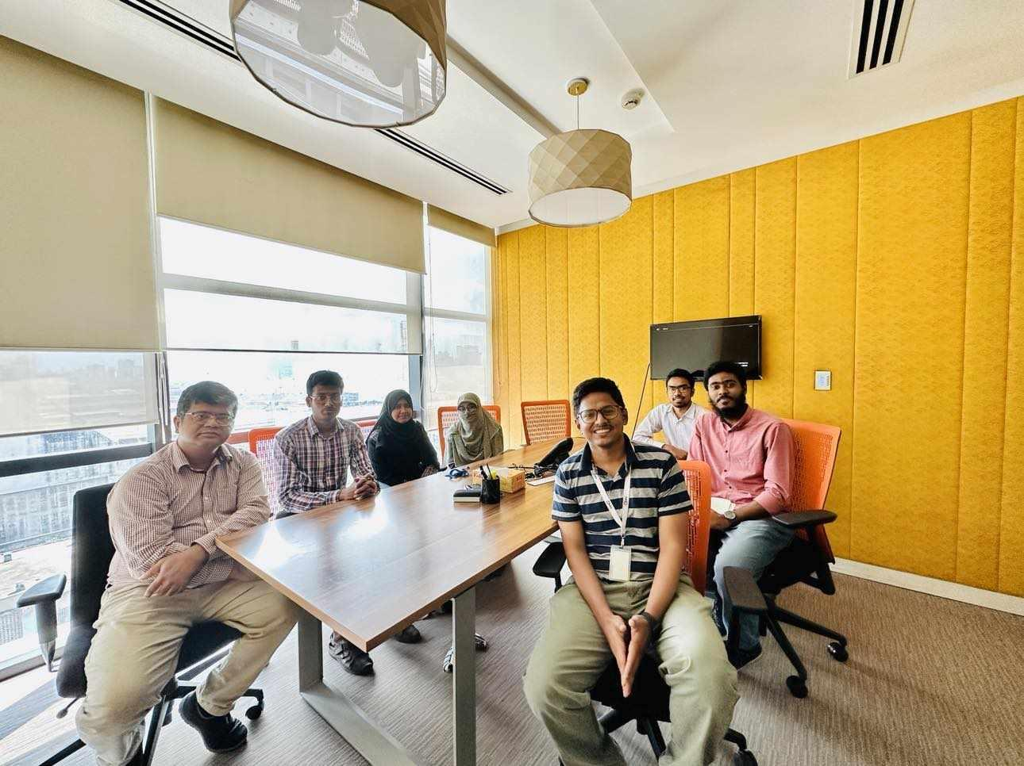
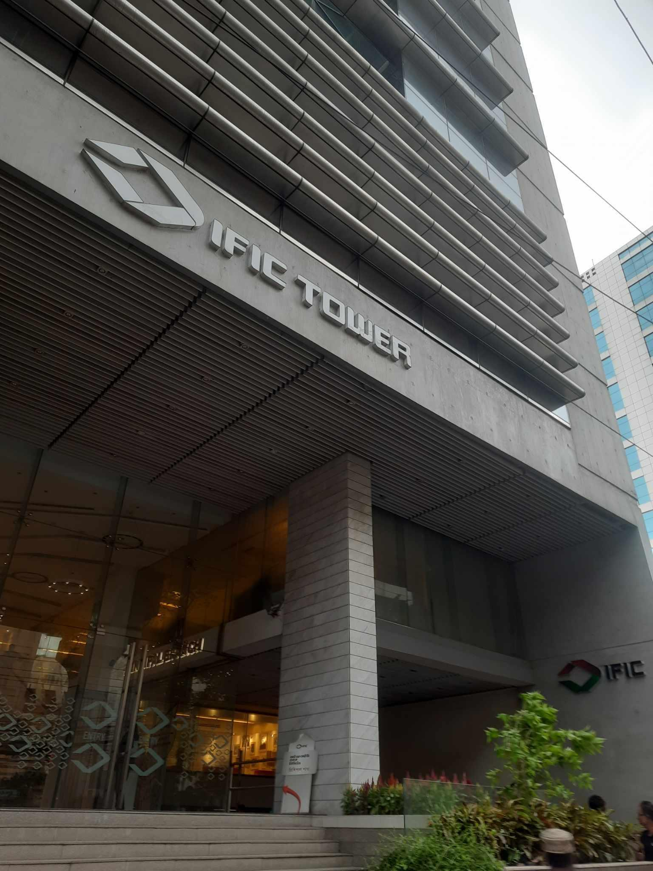
IFIC Bank
In the Meeting Room

Slide 4
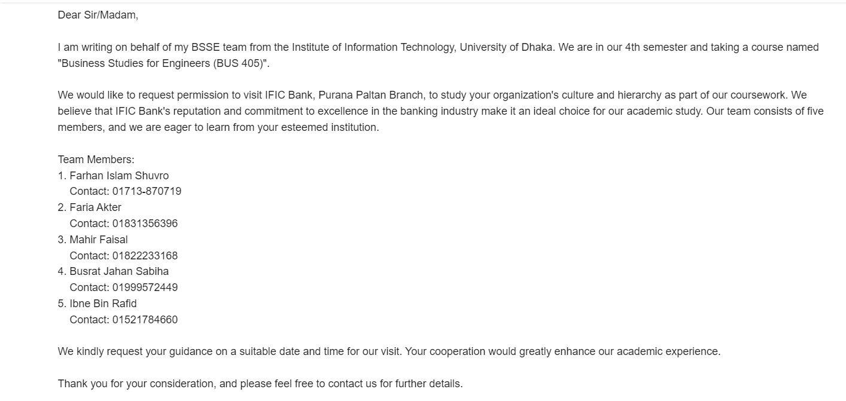
Appointment & Approval Approach:

Slide 5
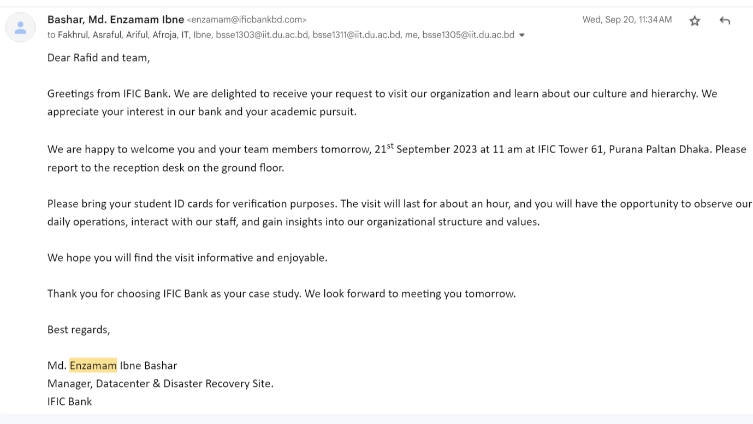

Slide 6
Question & Answer :
Organization’s structure
Departmentalization
Q : Which forms of departmentalization are implemented within your organization?
A : According to the manager, their organization adheres to all components of departmentalization such
➣ functional
➣ geographical
➣ product
➣ process
➣ customer

Slide 7
Organization’s structure(Continued)
Chain of Command
Q : What is the protocol for observing the chain of command within your organization?
A : Board of Directors
/ \
Managing Director & CEO
/ \
Deputy Managing Directors
/ \
Head of Divisions
/ \
Branch Managers
/ \
Other Officers and Staff

Slide 8
Organization’s structure(Continued)
Span of Control
Q : What is the span of control within your organization?
A : According to the manager, the organization's span of control across the overall sector is not predetermined or fixed.
Board of Directors: 8 members
Managing Director & CEO: 1 person
Deputy Managing Directors: 2 people
Head of Divisions: 15 people (overall)
Branch Managers: ➣ 80/90 people in call-center
➣ 40/50 people in IT Department

Slide 9
Organization’s structure(Continued)
Work specialization
Q : Is the work specialized or does it allow for flexibility?
A : Though the overall work procedure is specialized, if an employee demonstrates superior capabilities in a different role than their respective position, they may be reassigned to that role.

Slide 10
Organization’s structure(Continued)
Centralization
Q : Is the organizational structure of your establishment centralized or decentralized?
A : Fully centralized.

Slide 11
Organization’s structure(Continued)
Formalization
Q : Which communication protocol does the organization adhere to: formal or informal?
A : Any decision-making processes or new employee recruitment procedures are conducted via email. That means communication is fully formalized.

Slide 12
Scientific Method
Q : Is there a systematic approach or scientific method implemented within your organization?
A : They utilize various scientific methodologies across multiple sectors. Like
➣ IFIC digital account opening
➣ IFIC mobile app(Android & IOS)
➣ IFIC VIVR
➣ IFIC-MFS fund transfer
➣ Self service statement request
➣ Self service Income tax return proof submission

Slide 13
Organization Culture
Q : What characterizes the nature of management when viewed through the symbolic or omnipotent perspective?
A : Symbolic. That means Much of an organization’s success or failure is due to external forces outside of managers control.
Q : Dimensions of organizational culture?
A : Fully people oriented.
Q : Does the generation of a competitive or aggressive atmosphere among employees contribute to the success of the organization?
A : No.

Slide 14
Organization Culture(continued)
Q : Strong or weak cultures?
A : Strong. That means the key values of organization are widely shared.
Q : Do conflicts arise among the employees?
A : No. Conflict is preemptively addressed prior to its occurrence.
Q : Organizational design?
A : Fixed. That means organizational design is Mechanistic, there is no flexibility.

Slide 15
Q : Global perspective?
A : It exhibits characteristics of both Ethnocentrism and Polycentrism. The majority of work methodologies are formulated domestically. Apart from this they have branches in few countries including USA, Oman. Within those branches, the manager from the host country implements the most effective work approaches.

Slide 16
Security matters for over 1300+ branches of IFIC Bank nationwide are overseen from the Paltan branch. Taking into account local needs, unique and intriguing features have been incorporated, such as IFIC Shohoz, IFIC Aamar bari, IFIC Aamar protibeshi, Locker service, student file, etc. The utilization of these features has enhanced the accessibility of the banking system for the general populace.
The visit to this organization proved to be highly beneficial, providing us with valuable insights. The tour afforded us the opportunity to acquire entirely new knowledge. Through the aforementioned question-and-answer session, we gained an understanding of the organization's structure, culture, and security measures, appreciating its level of organization and cultural sophistication.

Slide 18
Thank You

